Slide 1







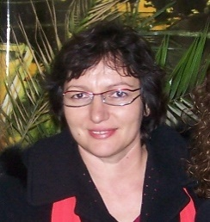

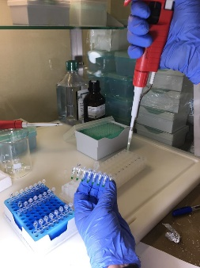
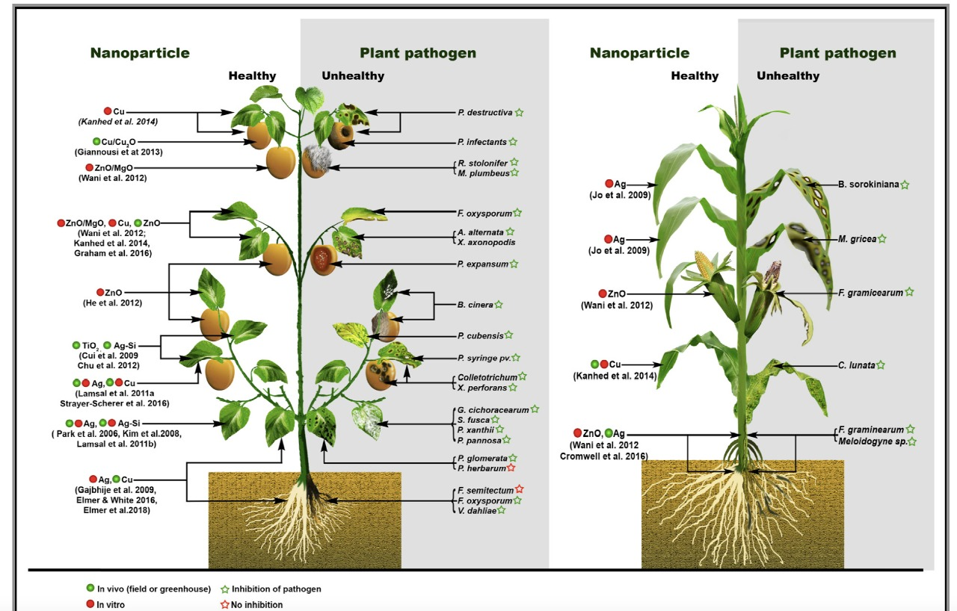
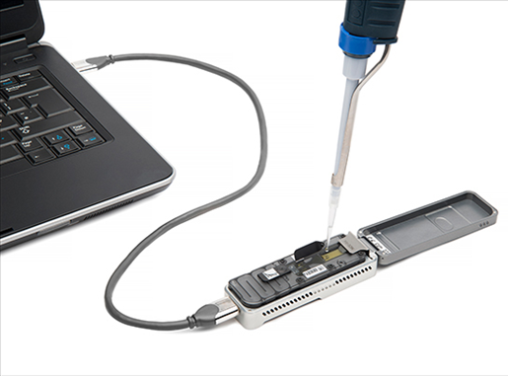
NANOTECHNOLOGY METHODS FOR AGRICULTURE RELATED DIAGNOSTIC
Contact person/Group leaders:
Prof. Dr. Magdalena CARA, Dr. Toufic Elbeaino
Affiliation
Department of Plant Protection, Faculty of Agriculture and Environment, Agricultural University of Tirana, Albania, Rruga “Paisi Vodica, Kodër-Kamëz, Tiranë,
magdacara@ubt.edu.al, www.ubt.edu.al,, https:/sites.google.com/a/ubt.edu.al/magdalena-cara//
Mail address
Email/website
Prof. Dr. Magdalena Cara, Dr. Toufic Elbeaino, PhD. Orges Cara, Dr. Bekri Xhemali, Dr. Valdete Sefa, Dr. Francesca Garganese, MSc. Klevis Hoxhallari, MSc. Florida Gashi, Luca Mandrini, Alessandro de Marchis, Prof.Dr. Jordan Merkuri
Group Members
Google Scholar
https://scholar.google.com/citations?user=qPw4KhIAAAAJ&hl=en
Research Gate
https://www.researchgate.net/profile/Magdalena-Cara
Research lines
Nano-phytopathology for the detection, diagnosis and control of plant diseases and their pathogens at an early stage, due to the protection of crops from epidemic diseases.
Nanoencapsulated conventional fertilizers, pesticides and herbicides.
Rapid detection of pesticide residue with nanoparticles.
Nanoparticles in agriculture in seed treatment and as biopesticide.

